Slide 1
LEGO Robotics
Lesson 2

Slide 2
Last lesson:
Input and output
Usage of different blocks
Port matters

Slide 3
Line following
Task:Follow the black line on the table
Tip: colour sensor can detect the black line

Slide 4
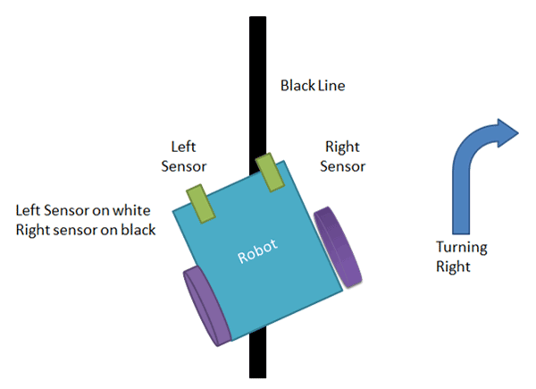
Solution
Simply turn to the right direction when it leaves the line !
Make the program yourself.

